Slide 1
CSE4004 – Web Technologies
Web Essentials:
Clients, Servers, and Communication

Slide 2
Web Essentials
Client: web browsers, used to surf the Web
Server systems: used to supply information to these browsers
Computer networks: used to support the browser-server communication
Request “document A”
document A
Client
Server

Slide 3
Internet vs. Web
The Internet: a inter-connected computer networks, linked by wires, cables, wireless connections, etc.
Web: a collection of interconnected documents and other resources.
The world wide web (WWW) is accessible via the Internet, as are many other services including email, file sharing, etc.

Slide 4
How does the Internet Work?
Through communication protocols
A communication protocol is a specification of how communication between two computers will be carried out
  IP (Internet Protocol): defines the packets that carry blocks of data from one node to another
  TCP (Transmission Control Protocol) and UDP (User Datagram Protocol): the protocols by which one host sends data to another.
  Other application protocols: DNS (Domain Name Service), SMTP (Simple Mail Transmission Protocol), and FTP (File Transmission Protocol)

Slide 5
The Internet Protocol (IP)
A key element of IP is IP address, a 32-bit number
The Internet authorities assign ranges of numbers to different organizations
IP is responsible for moving packet of data from node to node
A packet contains information such as the data to be transferred, the source and destination IP addresses, etc.
Packets are sent through different local network through gateways
A checksum is created to ensure the correctness of the data; corrupted packets are discarded
IP-based communication is unreliable

Slide 6
The Transmission Control Protocol (TCP)
TCP is a higher-level protocol that extends IP to provide additional functionality: reliable communication
TCP adds support to detect errors or lost data and to trigger retransmission until the data is correctly and completely received
Connection
Acknowledgment

Slide 7
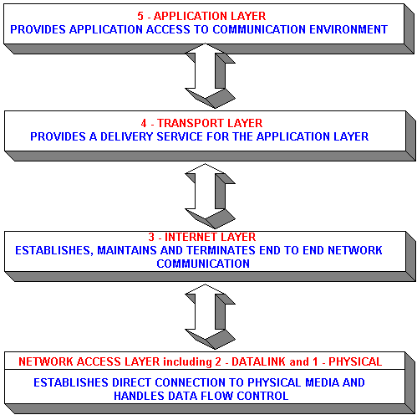
TCP/IP Protocol Suites
HTTP, FTP, Telnet, DNS, SMTP, etc.
TCP, UDP
IP (IPv4, IPv6)

Slide 8
Domain Name Service (DNS)
DNS is the “phone book” for the Internet
  Map between host names and IP addresses
Host names
  Labels separated by dots, e.g., www.example.org
  Final label is top-level domain
    Generic: .com, .org, etc.
    Country-code: .us, .il,.sa, etc.

Slide 9
The World Wide Web (WWW)
WWW is a system of interlinked, hypertext documents that runs over the Internet
Two types of software:
  Client: a system that wishes to access the information provided by servers must run client software (e.g., web browser)
  Server: an internet-connected computer that wishes to provide information to others must run server software
  Client and server applications communicate over the Internet by following a protocol built on top of TCP/IP – HyperText Transport Protocol (HTTP)

Slide 10
Basics of the WWW
Hypertext
Uniform Resource Locator (URL)
Markup language
Web Standards and the W3C Consortium

Slide 11

Hypertext
a format of information which allows one to move from one part of a document to another or from one document to another through hyperlinks

Slide 12
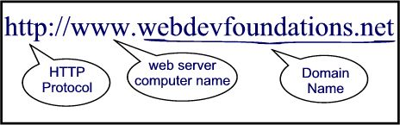
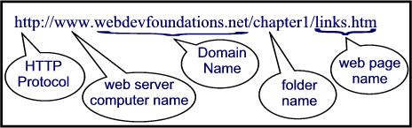
Uniform Resource Locator (URL)
unique identifiers used to locate a particular resource on the network

Slide 13
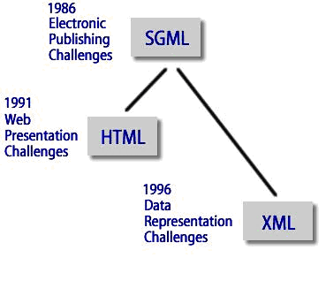
Markup language
defines the structure and content of hypertext documents

Slide 14
Web Standards and the W3C Consortium
W3C – World Wide Web Consortium
  takes a proactive role in developing recommendations and prototype technologies related to the Web
  produces specifications, called Recommendations, in an effort to standardize web technologies
  WAI – Web Accessibility Initiative
  Develops recommendations for
    web content developers,
    web authoring tool developers,
    developers of web browsers, and
    developers of other user agents to facilitate use of the web by those with special needs.

Slide 15
Web Client: Browser
Makes HTTP requests on behalf of the user
  Reformat the URL entered as a valid HTTP request
  Use DNS to convert server’s host name to appropriate IP address
  Establish a TCP connection using the IP address
  Send HTTP request over the connection and wait for server’s response
  Display the document contained in the response
    If the document is not a plain-text document but instead is written in HTML, this involves rendering the document (positioning text, graphics, creating table borders, using appropriate fonts, etc.)

Slide 16
Web Client: Browser
Many possible web clients:
  Text-only “browser”
  Mobile phones
  Robots (software-only clients)
  etc.
Standard features
  Save web page to disk
  Fill forms automatically (passwords, CC numbers, …)
  Set preferences (language, character set, cache and HTTP parameters)
  Modify display style (e.g., increase font sizes)
  Choose browser themes (skins)
  View history of web addresses visited
  Bookmark favorite pages for easy return

Slide 17
Web Client: Browser
Additional functionality:
  Execution of scripts (e.g., drop-down menus)
  Event handling (e.g., mouse clicks)
  GUI for controls (e.g., buttons)
  Secure communication with servers
  Display of non-HTML documents (e.g., PDF) via plug-ins

Slide 18
Web Servers
Main functionalities:
  Server waits for connect requests
  When a connection request is received, the server creates a new process to handle this connection
  The new process establishes the TCP connection and waits for HTTP requests
  The new process invokes software that maps the requested URL to a resource on the server
  If the resource is a file, creates an HTTP response that contains the file in the body of the response message
  If the resource is a program, runs the program, and returns the output

Slide 19
Static Web: HTML/XHTML, CSS
HTML stands for HyperText Markup Language
  It is a text file containing small markup tags that tell the Web browser how to display the page
XHTML stands for eXtensible HyperText Markup Language
  It is identical to HTML 4.01
  It is a stricter and cleaner version of HTML
CSS stands for Cascading Style Sheets
  It defines how to display HTML elements

Slide 20
Why Programmability?
What’s the drawback to simple document model?
  Static
  Assume that documents are created before they are requested
What are examples of information that might be part of web documents that may not be known before they are requested?

Slide 21
Client-Side Programmability
Scripting language: a lightweight programming language
Browser scripting: JavaScript
  Designed to add interactivity to HTML pages
  Usually embedded into HTML pages
  What can a JavaScript Do?
    Put dynamic text into an HTML page
    React to events
    Read and write HTML elements
    Validate data before it is submitted to a server
    Create cookies
    …

Slide 22
Server-Side Programmability
The requests cause the response to be generated
Server scripting:
  CGI/Perl: Common Gate Way Interface (*.pl, *.cgi)
  PHP: Open source, strong database support (*.php)
  ASP: Microsoft product, uses .Net framework (*.asp)
  Java via JavaServer Pages (*.jsp)
  …

Slide 23
CGI
Common Gateway Interface:
  CGI provides a way by which a web server can obtain data from (or send data to) database, and other programs, and present that data to viewers via the web.
  A CGI program can be written in any programming language, but Perl is one of the most popular

Slide 24
What’s Ahead?
HTML, XHTML
CSS
Simple client-side interactivity (JavaScript)
Simple server-side interactivity (CGI/Perl)
We will not “teach” these languages with all variants
We will provide an overview of the basics, and to help build a web page

